Slide 1
AID ESCALATING INTERNET COVERAGE
EVALUATION-2
Run through by Sanjeev & Rohan

Slide 2

Contents
NLP Preprocessing
TF-IDF vectorization
feature scaling and joining vectorize data with other feature columns
Train-Test Split
RANDOM FOREST

Slide 3
NLP PREPROCESSING
The isalpha() method returns True if all the characters are alphabet letters (a-z).Example of characters that are not alphabet letters: (space)!#%&? etc.
Stop Words: A stop word is a commonly used word (such as “the”, “a”, “an”, “in”) that a search engine has been programmed to ignore, both when indexing entries for searching and when retrieving them as the result of a search query. We would not want these words to take up space in our database, or taking up valuable processing time. For this, we can remove them easily, by storing a list of words that you consider to stop words.
word_tokenize: In Natural Language Processing, tokenization divides a string into a list of tokens. Tokens come in handy when finding valuable patterns and helping to replace sensitive data components with non-sensitive ones. word_tokenize is a function in Python that splits a given sentence into words using the NLTK library.

Slide 4


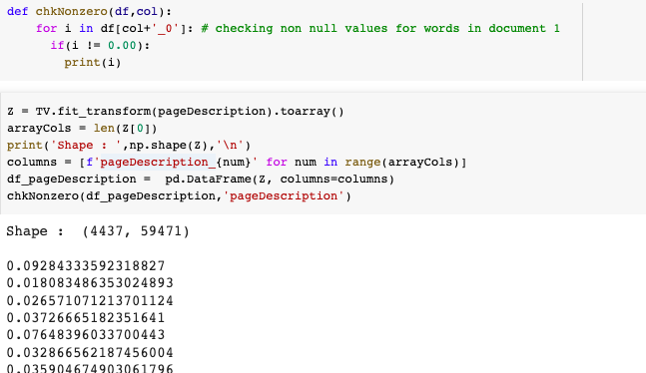

Slide 5
TFIDF VECTORIZATION
WHY TF-IDF over BoW?
the initial step of bag-of-words acts as a downside because it emphasizes words only based on counts. To overcome this, a simple twist to bag-of-words introduces the tf-idf approach.
Unlike, bag-of-words, tf-idf creates a normalized count where each word count is divided by the number of documents this word appears in.
bow(w, d) = # times word w appears in document d.
tf-idf(w, d) = bow(w, d) x N / (# documents in which word w appears)
Tip
min_df = 1 means "ignore terms that appear in less than 1 documents".

Slide 6
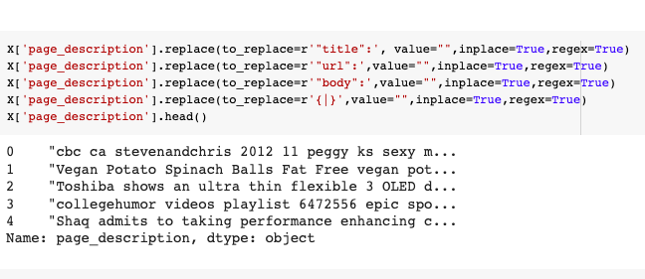
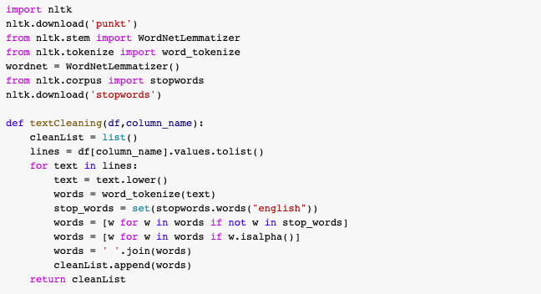

Slide 7
When data contains outliers, StandardScaler can often be mislead. In such cases,
it is better to use a
scaler that is robust
against outliers.
Tip
scaler = RobustScaler()
X = pd.DataFrame(scaler.fit_transform(X), columns=X.columns)

Slide 8

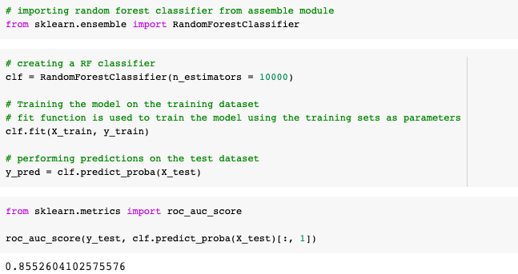
Accuracy of 85.5%

Slide 9

THANK YOU!
Rohan Arora(MT2022091)
Sanjeev Kumar(MT2022101)

